Slide 1


Slide 2
GUITAR 101 The BEGINNER COURSE : week 2

Slide 3
Sub – group for beginner class
Instrument | Guitar |  |  |  | Bass
Mentor | Jeff | Jethro | JR | PTEarl | Grej
 | RJ | Esa | Janice | Francis | Bong
 | ? | Rollie | PTVin | Mark | Rey

Slide 4
Part 1 : week 1 review

Slide 5
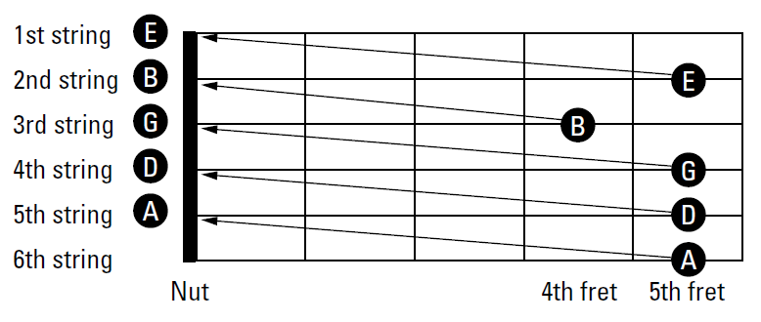
STANDARD tuning
E

Slide 6
Some tips for a clear chord sound
Do not over press the note
Press the note near the fretwire
Make sure the strings are not muted by the other hand and fingers
Check the proper spacing of fingers between strings

Slide 7
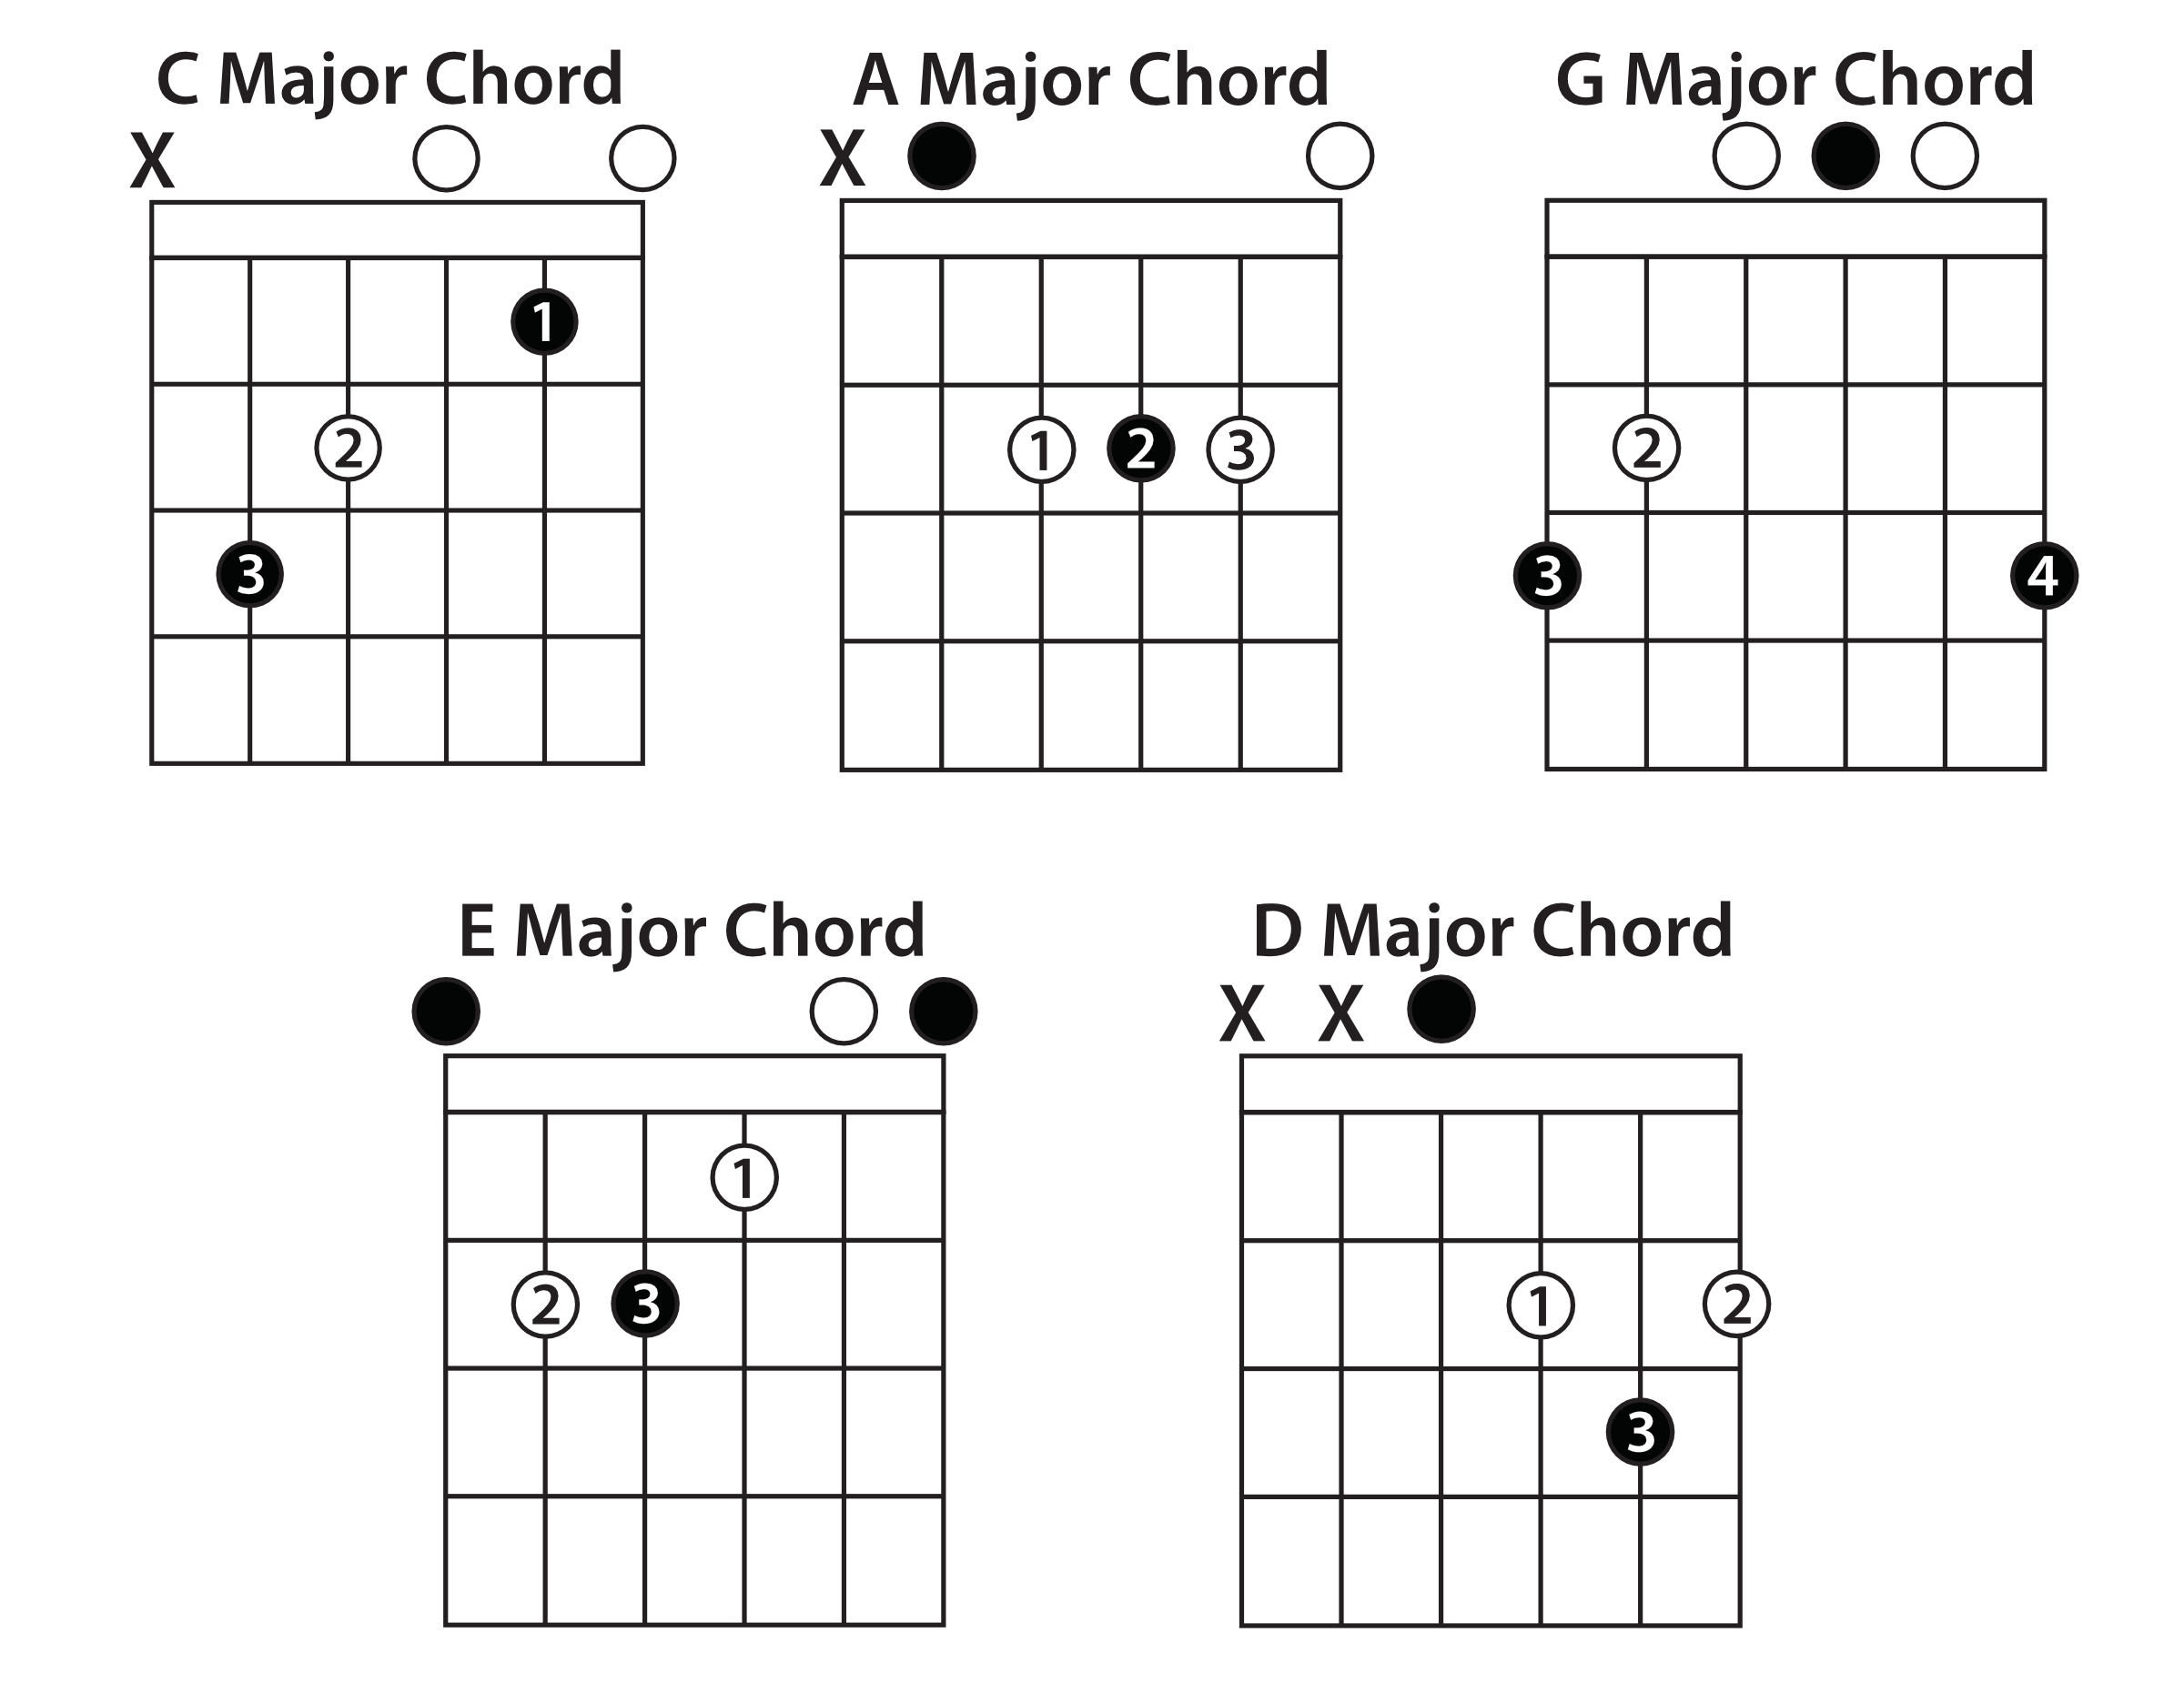
Remembering the shapes

Slide 8
Pass your assignments!

Slide 9
Play the song in key of A and D

Slide 10
Part 2 : minor chords

Slide 11
Sound difference between minor & major chords
Major chord has cheerier and brighter sound
Minor chord has sadder and darker sound
Only one note differs between them – the “3rd note (which will be discussed in later topics)”

Slide 12
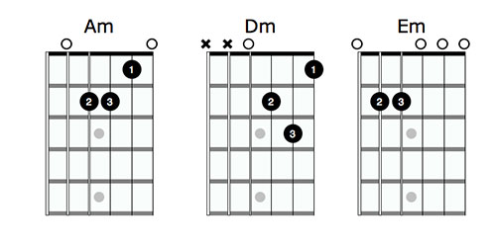
Your first minor chords: the Open minor chords

Slide 13
Part 3 : bar chords

Slide 14
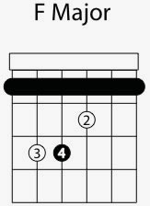
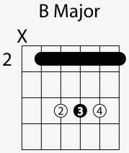
Your first bar chords : F and B Major
E shape
A shape

Slide 15
Your chord portfolio
CAGED
Am and Em
F and B
Bonus : Bm, C#m, F#m

